Slide 1
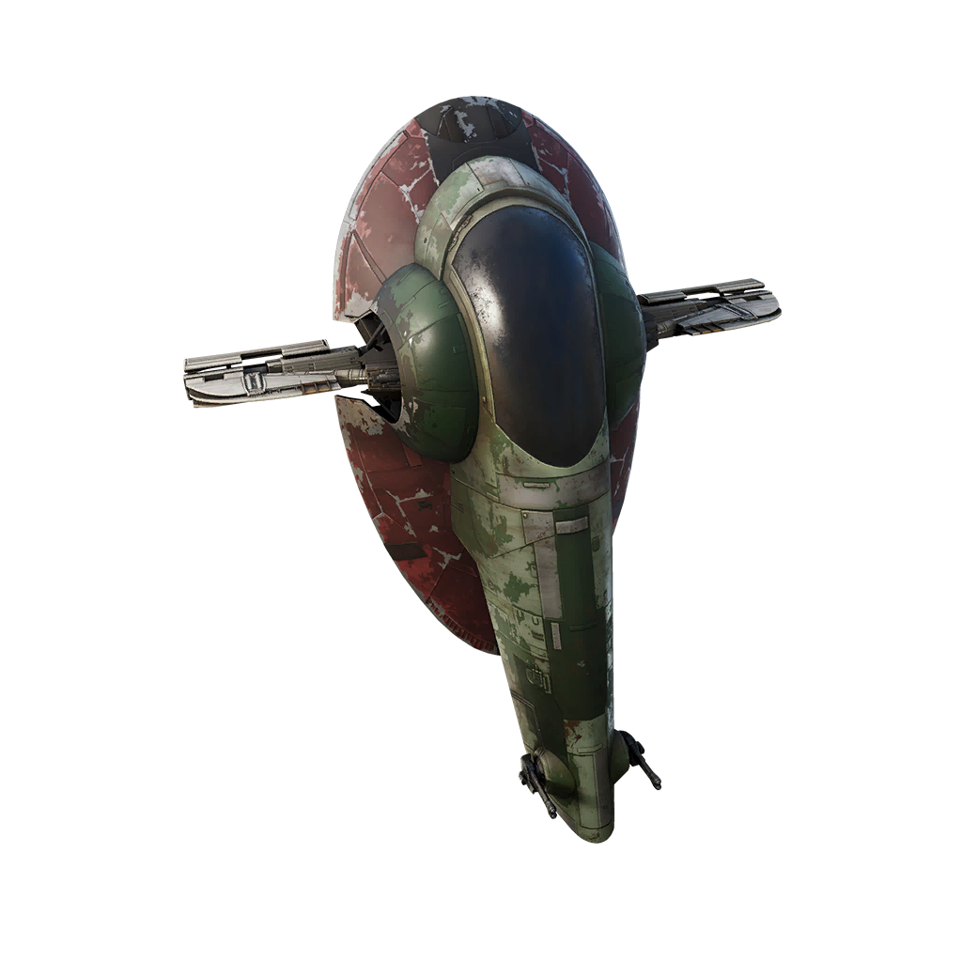
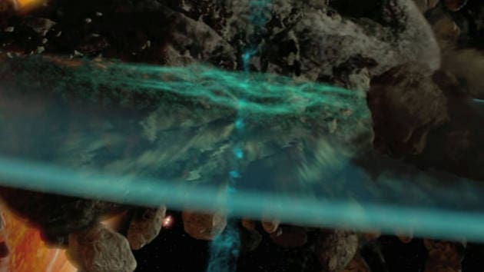
Star wars TM seismic charge CGP SHADER MINI-PROJECT
Tonko Bossen
Aalborg University, Medialogi 5
2. dec. 2022
Notes:
https://www.starwars.com/video/seismic-charges

Slide 2
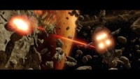

Slide 3


Slide 4


Slide 5
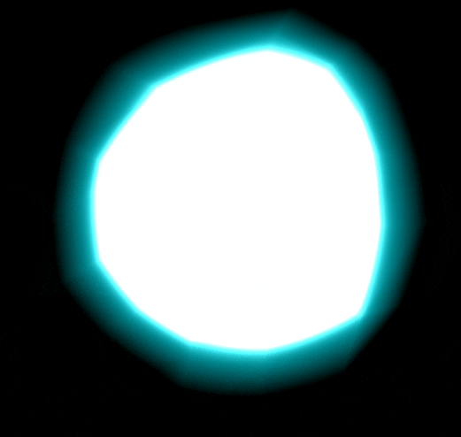
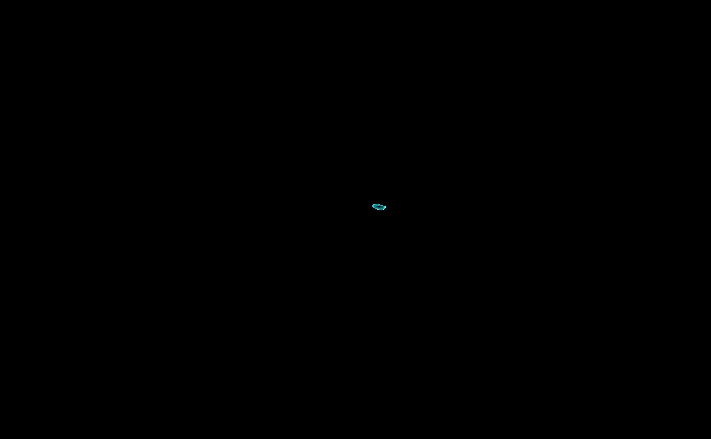
3 major elements
Bloom glimt
Smoke & cones wind-up
Disc expanding

Slide 6
Bloom glimt
Relative distance to camera
float dist = min(abs(unity_ObjectToWorld) * 1000,
length(ObjSpaceViewDir(v.vertex)) * 2);
Scale relative alpha and highlighted color fresnel

Slide 7

Relative distance to camera

Slide 8
Relative distance to camera

Slide 9
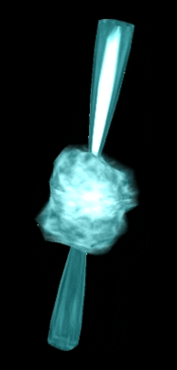
Smoke wind-up
Scale relative distortion using noise texture
Alpha and highlighted color fresnel
Smoke layering using noise texture
Flashing using hard noise texture

Slide 10
Cones wind-up
Fixed scale
Cut off
Curvature using normal and sin of y-values
Inner fresnel

Slide 11
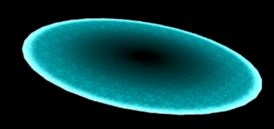
Disc expanding
Texture highlighting
Intensity animation
White light outer rim
Fade out after specific size

Slide 12
General
Clipping depended to size and positive/negative values

Slide 13
Fresnel

